Slide 1


A
PROJECT PRESENTATION
on
Design and Implementation of a Scalable
Telecom Customer Churn Prediction and
Retention Platform using PySpark and
Machine Learning
MCA SEM IV (Batch 2024–26)
PRESENTED BY
Divyesh S. Joshi
Seat No.: 52419 | Roll No.: MC24097
UNDER THE GUIDANCE OF
Prof. Yugandhara Patil
YASHASWI EDUCATION SOCIETY'S
IIMS Chinchwad, Pune
Savitribai Phule Pune University
Design and Implementation of a Scalable Telecom Customer Churn Prediction and Retention Platform
Notes:
1

Slide 2
Content
Introduction
Company Profile
Problem Statement & Objectives
Scope of Project
Technology Used
System Analysis — Functional & Non-Functional Requirements
UML Diagrams (Use Case, Class, Activity, Sequence, Component)
ER Diagram & Database Design
Screenshots & Reports
Test Cases & Results
Limitations of the System
Future Enhancements
Conclusion
References & Annexure (Sample Code)
Design and Implementation of a Scalable Telecom Customer Churn Prediction and Retention Platform
Notes:
2

Slide 3
Introduction
What is Customer Churn?
Customer churn is when subscribers discontinue a service and switch to competitors — a critical challenge for telecom companies worldwide.
The Business Problem
The IBM Telco dataset reveals a 26.5% churn rate, representing significant monthly revenue loss. Manual churn identification is slow, subjective, and does not scale to enterprise data volumes.
Our Solution
An end-to-end, production-grade ETL + ML + Dashboard platform that automatically predicts churn, classifies customer risk, and generates personalised retention offers — secured by role-based authentication.
7,043
26.5%
Customers
Churn Rate
3
48
ML Models
Unit Tests
Design and Implementation of a Scalable Telecom Customer Churn Prediction and Retention Platform
Notes:
3

Slide 4
Company Profile
D-Table Analytics
D-Table Analytics is a technology and analytics company providing solutions in data analytics, business intelligence, software development, and process automation.
Core Focus Areas:
Transforming raw data into meaningful insights for better decision-making
Customised web applications, reporting systems, dashboards, and automation tools
Practical and scalable technology solutions using AI and cloud-based systems
Workflow management, data handling, and digital transformation processes
This project was developed as part of the On-Job Training (OJT) requirement for MCA Sem IV at IIMS Chinchwad, Pune under D-Table Analytics.
Design and Implementation of a Scalable Telecom Customer Churn Prediction and Retention Platform
Notes:
4

Slide 5
Objectives of the Proposed System
1. Design and implement a complete ETL pipeline using Python, Pandas, and PySpark
2. Clean, transform, and engineer features from the IBM Telco Customer Churn dataset (7,043 records)
3. Train and evaluate 3 ML models (Random Forest, Gradient Boosting, Logistic Regression); auto-select best by ROC-AUC
4. Score all customers with ChurnProbability and ChurnRisk (High / Medium / Low) classification
5. Generate personalised retention offers using a 7-strategy recommendation engine
6. Develop a secure, role-based Streamlit analytics dashboard with 5 interactive pages
7. Implement enterprise-grade PBKDF2-SHA256 authentication with session management and audit logging
8. Demonstrate scalable distributed data processing using Apache PySpark 3.5
9. Achieve 100% unit test pass rate across all ETL, ML, and auth modules (48 tests)
Design and Implementation of a Scalable Telecom Customer Churn Prediction and Retention Platform
Notes:
5

Slide 6
Scope of the Proposed System
ETL Pipeline: CSV extraction → data cleaning → feature engineering → PostgreSQL loading
Machine Learning: 3 classification models trained; best model auto-selected by ROC-AUC score; batch customer scoring
Retention Engine: 7-strategy personalised retention offer recommendation engine mapped to customer risk profiles
Streamlit Dashboard: 5-page interactive dashboard: Executive Dashboard, Churn Predictor, At-Risk Customers, Model Performance, Admin Panel
Authentication: PBKDF2-SHA256 hashing, session management via st.session_state, complete access logging to CSV
PySpark Integration: Enterprise-scale distributed processing pipeline supporting 1M+ records in cluster mode
Test Suite: 48 unit tests across 9 test classes covering all modules — 100% pass rate achieved
Design and Implementation of a Scalable Telecom Customer Churn Prediction and Retention Platform
Notes:
6

Slide 7

Technology Used
Component | Technology / Framework | Version
Frontend / Dashboard | Streamlit (Python-based web UI framework) | 1.35+
Visualisation | Plotly Express and Plotly Graph Objects | 5.20+
Backend Language | Python | 3.11+
Data Processing | Pandas, NumPy | 2.0+
Big Data Processing | Apache PySpark (local and cluster mode) | 3.5
Machine Learning | scikit-learn, XGBoost | 1.4 / 2.0
Database | PostgreSQL via SQLAlchemy | 15 / 2.0
Authentication | PBKDF2-SHA256 (Python hashlib), st.session_state | —
Testing | pytest, pytest-cov | 8.0+
Version Control | Git and GitHub | —
Dataset | IBM Telco Customer Churn — Kaggle (7,043 records, 21 cols) | —
Design and Implementation of a Scalable Telecom Customer Churn Prediction and Retention Platform
Notes:
7

Slide 8
Functional Requirements
FR ID | Module | Requirement Description
FR-01 | ETL | Extract data from IBM Telco CSV; validate all 21 required columns
FR-02 | ETL | Clean data: fix TotalCharges type, impute median, remove duplicates
FR-03 | ETL | Engineer features: tenure_group, RevenueCategory, AnnualRevenue, LoyaltyScore
FR-04 | ETL | Load cleaned and scored data to PostgreSQL in two tables
FR-05 | ML | Train 3 ML models; auto-select best by ROC-AUC score
FR-06 | ML | Score all customers with ChurnProbability and ChurnRisk (High/Medium/Low)
FR-07 | Recommend | Generate personalised retention offers for at-risk customers
FR-08 | Dashboard | Display KPIs, charts, and at-risk lists across 5 Streamlit pages
FR-09 | Auth | Authenticate users with PBKDF2-SHA256 hashed passwords
FR-10 | Admin | Admin: add/delete users, change passwords, view complete access log
Design and Implementation of a Scalable Telecom Customer Churn Prediction and Retention Platform
Notes:
8

Slide 9
UML Diagrams
Use Case Diagram
Two actors: User (login, dashboard, predictor, export) and Admin (all user actions + ETL execution, user management, access log)
Activity Diagram
ETL pipeline flow: CSV extraction → column validation → backup → cleaning → feature engineering → ML training → scoring → offer generation → PostgreSQL load
Class Diagram
8 core classes: DataExtractor, DataTransformer, DataLoader, ModelTrainer, ChurnPredictor, OfferEngine, AuthManager, SparkETL
Component Diagram
All system components across 3 layers: processing (CSV→extract→transform→train), logic (load→predict→recommend→auth→app), storage (DB/files)
Sequence Diagram
Login sequence (PBKDF2 verification → access log) and Prediction sequence (predict_proba() → offer card → gauge chart)
Module Hierarchy
4 top-level subsystems: ETL Layer, ML Layer, App Layer, Auth Layer — each decomposed to individual functions and methods
Design and Implementation of a Scalable Telecom Customer Churn Prediction and Retention Platform
Notes:
9

Slide 10
ER Diagram & Database Design
The system uses PostgreSQL as the primary analytical store with two main tables. User credentials are stored in users.json and the access log is maintained in logs/access_log.csv.
customer_churn_raw
customer_churn_cleaned (key columns)
Column Name | Data Type | Constraint | Description
customerID | VARCHAR(50) | PRIMARY KEY | Unique 7-char customer ID
gender | VARCHAR(10) | NULL | Male or Female
SeniorCitizen | SMALLINT | NULL | 0 = No, 1 = Yes
tenure | INT | NULL | Months with company
MonthlyCharges | FLOAT | NULL | Monthly billing amount
TotalCharges | FLOAT | NULL | Cumulative charges
Contract | VARCHAR(50) | NULL | Month-to-month / 1yr / 2yr
Churn | VARCHAR(10) | NULL | Yes or No (raw label)
Column Name | Data Type | Description
customerID | VARCHAR(50) | PRIMARY KEY — unique ID
Churn | SMALLINT | 1 = Churned, 0 = Retained
tenure_group | VARCHAR(20) | 0-1yr, 1-2yr, 2-4yr, 4-6yr
RevenueCategory | VARCHAR(10) | Low / Medium / High
AnnualRevenue | FLOAT | MonthlyCharges × 12
LoyaltyScore | FLOAT | Normalised tenure (0.0–1.0)
ChurnProbability | FLOAT | ML predicted probability
ChurnRisk | VARCHAR(10) | Low / Medium / High risk tier
OfferTitle | VARCHAR(100) | Recommended retention offer
Design and Implementation of a Scalable Telecom Customer Churn Prediction and Retention Platform
Notes:
10

Slide 11
Data Dictionary — Key Fields
Field Name | Type | Range / Values | Description
customerID | String | Unique | 7-character alphanumeric ID assigned to each customer
tenure | Integer | 0 to 72 | Number of months the customer has been with the company
MonthlyCharges | Float | 18.25 – 118.75 | Amount charged to the customer monthly in USD
TotalCharges | Float | 18.85 – 8684.8 | Total amount charged; blank entries imputed with median
Churn | Binary Int | 0 or 1 | Target variable: 1 = churned, 0 = retained
ChurnProbability | Float | 0.0 to 1.0 | ML-predicted probability of churn for each customer
ChurnRisk | String | Low / Med / High | Low < 35%, Medium 35–65%, High > 65%
LoyaltyScore | Float | 0.0 to 1.0 | Normalised tenure: tenure / maximum tenure
AnnualRevenue | Float | 219 – 1425 | Projected annual revenue: MonthlyCharges × 12
RevenueCategory | String | Low/Med/High | Low < ₹35, Medium ₹35–70, High > ₹70 monthly
OfferTitle | String | 7 offer types | Recommended retention offer for each at-risk customer
Design and Implementation of a Scalable Telecom Customer Churn Prediction and Retention Platform
Notes:
11

Slide 12
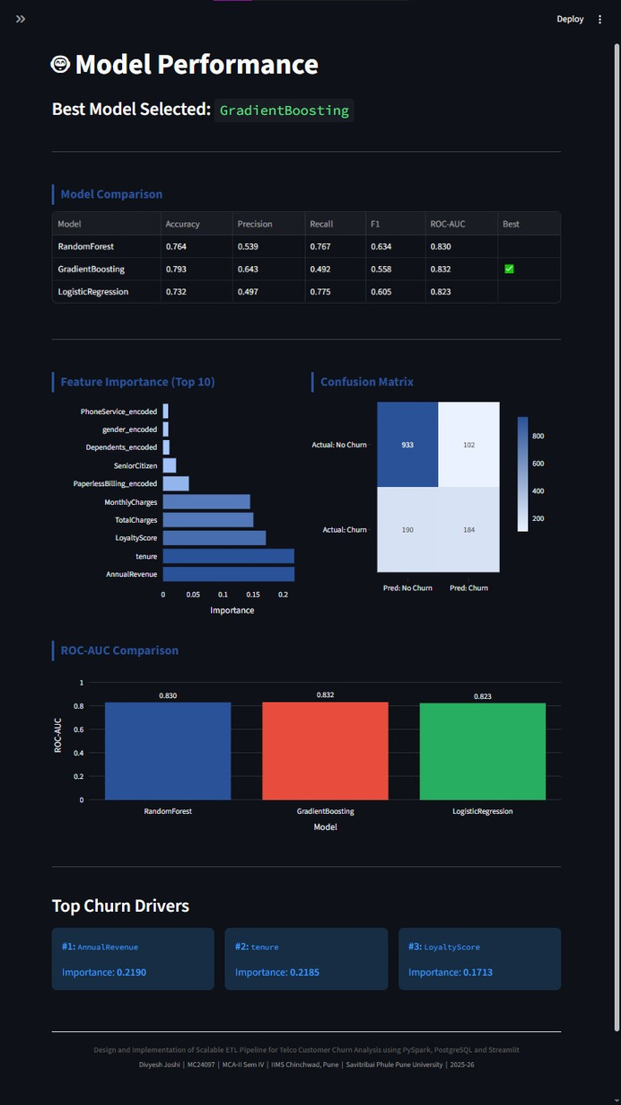
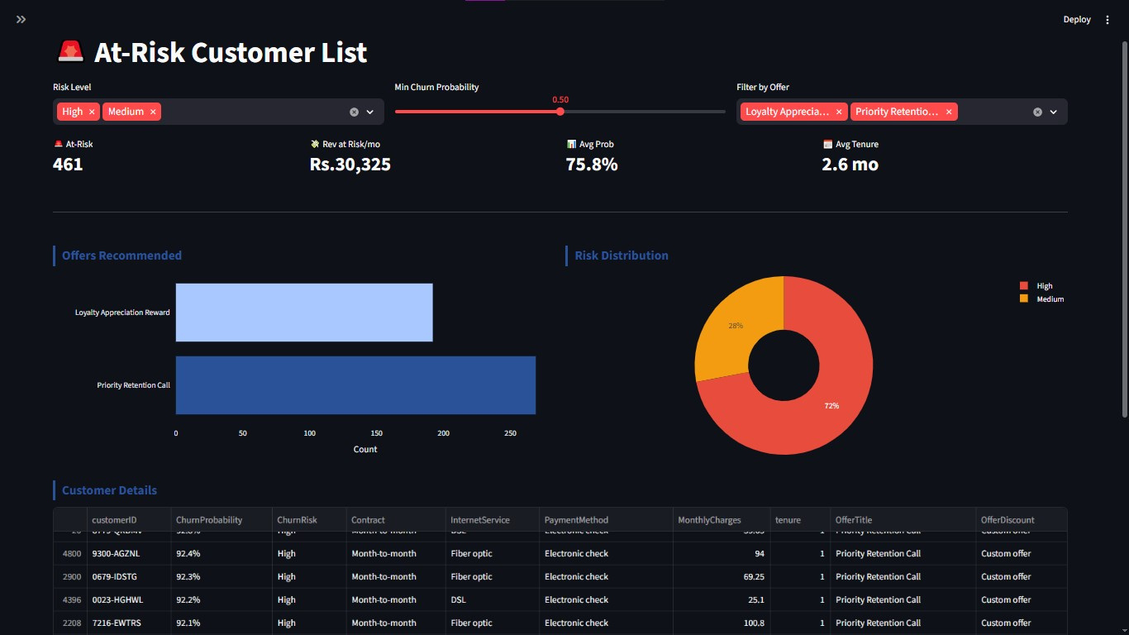
Screenshots & Reports
Comparison table (Accuracy, Precision, Recall, F1, ROC-AUC), confusion matrix heatmap, feature importance chart, ROC-AUC bar chart.
Filterable & sortable table: customerID, ChurnProbability, ChurnRisk, Contract, InternetService, MonthlyCharges, OfferTitle. CSV export.
Design and Implementation of a Scalable Telecom Customer Churn Prediction and Retention Platform
Notes:
12

Slide 13
Test Cases — Unit Test Plan (ETL Pipeline)
Test ID | Test Case | Input / Condition | Expected Result
TC-E01 | Validate columns — pass | All required columns present | No exception raised
TC-E02 | Validate columns — fail | Missing column | ValueError raised
TC-E03 | Dataset shape correct | Sample DataFrame | shape[1] == 21
TC-E04 | CustomerID unique | Sample DataFrame | Unique IDs only
TC-E05 | Dataset not empty | Loaded DataFrame | len(df) > 0
TC-C01 | TotalCharges numeric | Cleaned DataFrame | dtype == float64
TC-C02 | No null TotalCharges | Raw blank values | No nulls remain
TC-C03 | No duplicate rows | Cleaned DataFrame | 0 duplicates
TC-C04 | Strings stripped | Object columns | No extra spaces
TC-T01 | Churn binary encoded | Transformed DataFrame | Values in {0,1}
TC-T02 | Contract preserved after OHE | After encoding | Column exists
TC-T03 | InternetService preserved | After encoding | Column exists
TC-F01 | AnnualRevenue calculation | Featured DataFrame | Monthly × 12 correct
TC-F02 | LoyaltyScore range valid | Featured DataFrame | 0 ≤ score ≤ 1
Design and Implementation of a Scalable Telecom Customer Churn Prediction and Retention Platform
Notes:
13

Slide 14
Test Cases — ML, Prediction, Auth & Acceptance
Unit Tests — ML, Prediction & Auth Modules
Acceptance Test Results
Test ID | Test Case | Expected Result
TC-P01 | Predict returns dictionary | Valid keys returned
TC-P02 | Probability range valid | 0.0 ≤ p ≤ 1.0
TC-R01 | High-risk contract offer generated | Offer assigned
TC-R02 | Retention call for very high-risk | RETENTION_CALL
TC-R03 | Offer fields present in output | Required fields exist
TC-A01 | Password hash verify — correct | Verification succeeds
TC-A02 | Wrong password fails verification | Verification fails
TC-A03 | Add/delete user flow | User added then removed
AT ID | Scenario | Result
AT-01 | Login with valid credentials | ✓ Pass
AT-02 | Wrong password — access denied | ✓ Pass
AT-03 | Run ETL pipeline — CSV generated | ✓ Pass
AT-04 | Dashboard loads — KPIs shown | ✓ Pass
AT-05 | High-risk prediction → offer | ✓ Pass
AT-06 | Filter high-risk users | ✓ Pass
AT-07 | CSV export download | ✓ Pass
AT-08 | Admin adds new user | ✓ Pass
AT-09 | Role restriction enforced | ✓ Pass
AT-10 | Access log timestamps recorded | ✓ Pass
Design and Implementation of a Scalable Telecom Customer Churn Prediction and Retention Platform
Notes:
14

Slide 15
Test Results Summary
Test Class | Total Tests | Passed | Skipped | Failed
TestExtract | 5 | 5 | 0 | 0
TestCleaning | 6 | 6 | 0 | 0
TestTransform | 10 | 10 | 0 | 0
TestFeatureEngineering | 7 | 7 | 0 | 0
TestValidation | 3 | 3 | 0 | 0
TestPredict | 3 | 3 | 0 | 0
TestRecommend | 7 | 7 | 0 | 0
TestAuth | 4 | 4 | 0 | 0
TestConfig | 3 | 3 | 0 | 0
TOTAL | 48 | 48 | 0 | 0
🎯 100% Pass Rate — All 48 unit tests passed across 9 test classes
Design and Implementation of a Scalable Telecom Customer Churn Prediction and Retention Platform
Notes:
15

Slide 16
Limitations of the System
Dataset Scope: Uses IBM Telco sample (7,043 records) — may not represent all telecom segments, regional billing patterns, or enterprise-scale data volumes.
Rule-Based Offers: Retention offer engine uses rule-based logic. Collaborative filtering or reinforcement learning would generate more granular, personalised recommendations.
Credential Storage: User credentials stored in a flat users.json file. A dedicated PostgreSQL users table would be more robust and auditable at enterprise scale.
No Real-Time Ingestion: Streamlit dashboard does not support real-time data ingestion. The ETL pipeline must be re-run manually to refresh customer scores.
PySpark in Local Mode: PySpark runs in local mode. A distributed cluster deployment (AWS EMR, Databricks, or Azure HDInsight) is required for true enterprise scalability.
No Notifications: No email or SMS notification capability to alert the retention team when a customer crosses the high-risk churn threshold.
Design and Implementation of a Scalable Telecom Customer Churn Prediction and Retention Platform
Notes:
16

Slide 17
Future Enhancements
01
02
03
04
Apache Airflow
Real-Time Streaming
Advanced ML Models
Cloud Deployment
Automate ETL pipeline scheduling using DAGs for daily/weekly data refresh without manual intervention
Integrate Apache Kafka for real-time customer event ingestion and immediate churn risk recalculation
Implement neural networks (TensorFlow/PyTorch) and AutoML for improved prediction accuracy
Host on AWS (S3+RDS+EC2) or Azure (Blob Storage+Azure SQL+App Service) for production availability
05
06
07
08
SHAP Explainability
REST API Layer
Power BI Integration
Snowflake DWH
Integrate SHAP values to provide human-readable explanations for each individual churn prediction
Expose prediction and recommendation endpoints via FastAPI for CRM and billing system integration
Export scored data to Power BI for enterprise-grade business intelligence and executive reporting
Migrate analytical storage to Snowflake for columnar querying and seamless BI tool integration
Design and Implementation of a Scalable Telecom Customer Churn Prediction and Retention Platform
Notes:
17

Slide 18
Conclusion
This project successfully demonstrates the design and implementation of a complete, production-grade ETL pipeline for Telecom Customer Churn Analysis — integrating data engineering, machine learning, and business intelligence into a unified deployable platform built entirely on open-source technologies.
✓ ETL Pipeline: Complete pipeline processing 7,043 customer records end-to-end
✓ ML Pipeline: 3 models trained; best auto-selected by ROC-AUC; batch scoring applied
✓ Risk Classification: Three-tier churn risk (High/Medium/Low) for all 7,043 customers
✓ Retention Engine: 7-strategy personalised offer recommendation engine
✓ Dashboard: 5-page Streamlit dashboard with role-based access control
✓ Authentication: Secure PBKDF2-SHA256 auth with complete audit logging
✓ PySpark: Enterprise-scale distributed processing integration demonstrated
✓ Test Suite: 100% pass rate — 48 unit tests across 9 test classes
Design and Implementation of a Scalable Telecom Customer Churn Prediction and Retention Platform
Notes:
18

Slide 19
References / Bibliography
[1] IBM Sample Datasets. (2024). Telco Customer Churn Dataset. Kaggle. https://www.kaggle.com/blastchar/telco-customer-churn
[2] Apache Software Foundation. (2024). PySpark API Documentation — Apache Spark 3.5. https://spark.apache.org/docs/latest/api/python/
[3] Streamlit Inc. (2024). Streamlit Documentation. https://docs.streamlit.io
[4] scikit-learn Developers. (2024). scikit-learn: Machine Learning in Python. Journal of Machine Learning Research, 12, 2825–2830.
[5] McKinney, W. (2022). Python for Data Analysis (3rd ed.). O'Reilly Media.
[6] SQLAlchemy Authors. (2024). SQLAlchemy Documentation. https://docs.sqlalchemy.org
[7] PostgreSQL Global Development Group. (2024). PostgreSQL 15 Documentation. https://www.postgresql.org/docs/15/
[8] Chen, T., and Guestrin, C. (2016). XGBoost: A Scalable Tree Boosting System. Proceedings of KDD 2016, 785–794.
[9] Plotly Technologies Inc. (2024). Plotly Python Open-Source Graphing Library. https://plotly.com/python/
[10] pytest Development Team. (2024). pytest Documentation. https://docs.pytest.org
[11] Kleppmann, M. (2017). Designing Data-Intensive Applications. O'Reilly Media.
[12] Provost, F., and Fawcett, T. (2013). Data Science for Business. O'Reilly Media.
Design and Implementation of a Scalable Telecom Customer Churn Prediction and Retention Platform
Notes:
19

Slide 20
Annexure — Sample Code
extract.py — Data Extraction
auth.py — Password Hashing (PBKDF2-SHA256)
def extract_data(filepath):
if not os.path.exists(filepath):
raise FileNotFoundError(...)
df = pd.read_csv(filepath)
validate_columns(df, REQUIRED_COLUMNS)
shutil.copy2(filepath, BACKUP_DATA)
return df
def _hash_password(password):
salt = os.urandom(32).hex()
key = hashlib.pbkdf2_hmac(
"sha256", password.encode(),
salt.encode(), 260_000)
return f"{salt}:{key.hex()}"
train_model.py — ML Training
recommend.py — Retention Offer Engine
models = {
"RandomForest": RandomForestClassifier(
n_estimators=200, class_weight="balanced"),
"GradientBoosting": GradientBoostingClassifier(
n_estimators=150, learning_rate=0.08),
}
for name, model in models.items():
auc = roc_auc_score(y_test, model...)
if auc > best_auc: best_model = model
def recommend_offer(row):
prob = row["ChurnProbability"]
if prob >= 0.80:
return OFFERS["RETENTION_CALL"]
if row["SeniorCitizen"]==1:
return OFFERS["SENIOR_PLAN"]
if "Month-to-month" in row["Contract"]:
return OFFERS["CONTRACT_UPGRADE"]
return OFFERS["STANDARD_LOYALTY"]
Design and Implementation of a Scalable Telecom Customer Churn Prediction and Retention Platform
Notes:
20

Slide 21
Thank you!!
PRESENTED BY
Divyesh S. Joshi
Seat No.: 52419 | Roll No.: MC24097
Design and Implementation of a Scalable Telecom Customer Churn Prediction and Retention Platform
Notes:
1

